Slide 1
Data Science Jobs Market
United States, Canada, United Kingdom, Australia
Presenters: May Ang, Kelvin Deng, Yijing Su, Thao Hoang
Date: Feb 18, 2021
Notes:
Su

Slide 2
Agenda
Project motivation
ETL process
Dashboard creation process
Results
Summary of insights
Future works
Q&A

Slide 3
Project motivation
1
What questions do we answer?
Notes:
Su

Slide 4
Project Motivation
Data are becoming the new raw material of business." – BY CRAIG MUNDIE, SENIOR ADVISOR TO THE CEO AT MICROSOFT
Notes:
Summarize the intro

Slide 5
Objectives
To understand job availability in different countries:
Canada
United States
Singapore
Australia
To understand job availability by job types:
Data Analyst
Data Scientist
Data Engineer
Machine Learning roles

Slide 6
ETL Process
2
Data extraction
Data transformation
Data loading and storage
Notes:
May

Slide 7
Assumptions
Job postings were scraped from Indeed on 15 December 2020
Job types were categorized by Indeed for simplification purpose
Capped job postings at 1000, per job type and per country

Slide 8


Extraction
Challenges!
Job postings from Indeed (Web Scrape)
Domain extension (e.g. indeed.ca)
Health and wellness surveys (csv)
Kaggle
Latitude and Longitude (API)
api.opencagedata.com
Solutions:
1/ Time delay
2/ User Agent
3/ Proxy
4/ VPN

Slide 9
Transformation
Data inconsistencies
Indeed job postings (location)
Survey responses (gender, typos)
Foreign Keys
Country
Job type

Slide 10
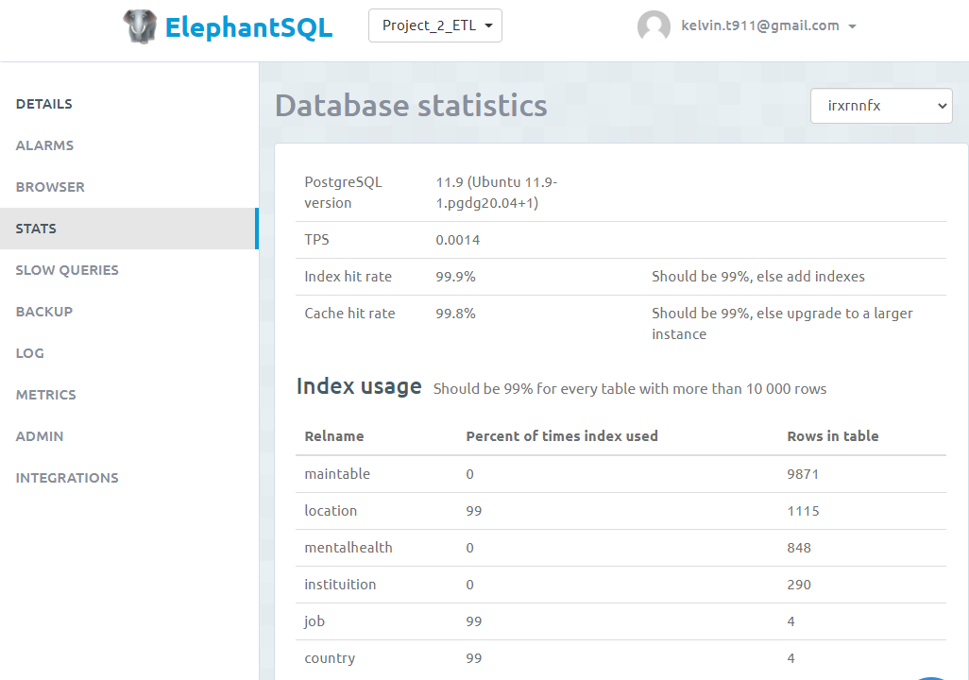

Load

Slide 11
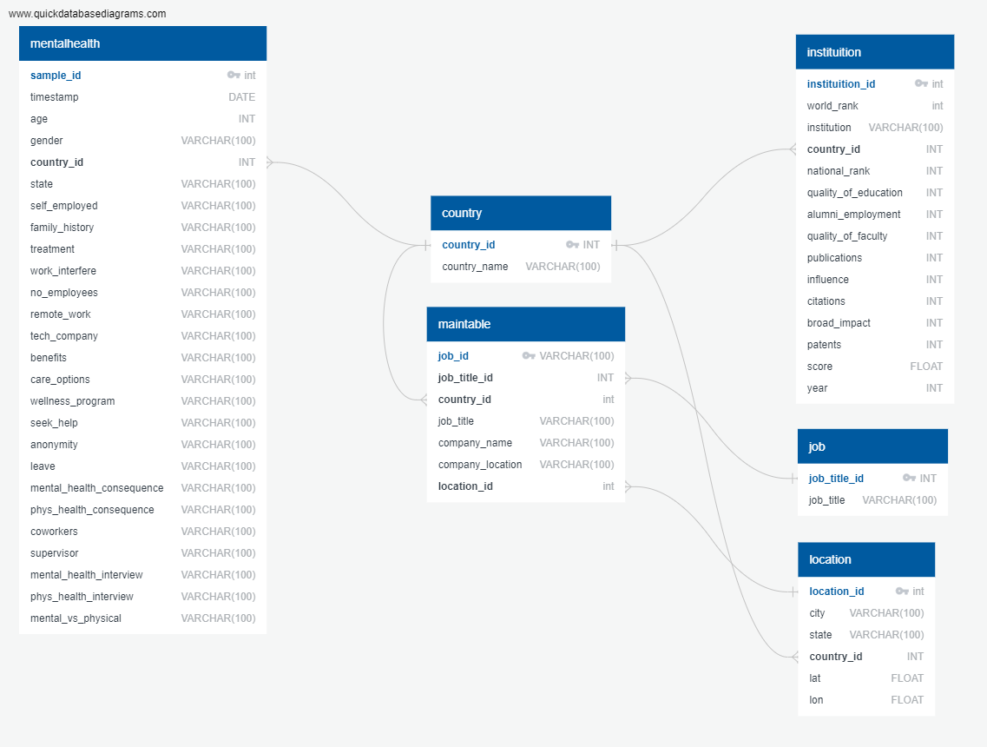
Relational Database
Related by:
Country
Job type
Location (City, State)

Slide 12
Dashboard Creation Process
3
Data querying from database
Charts creation
Dashboard design
Notes:
Kelvin

Slide 13
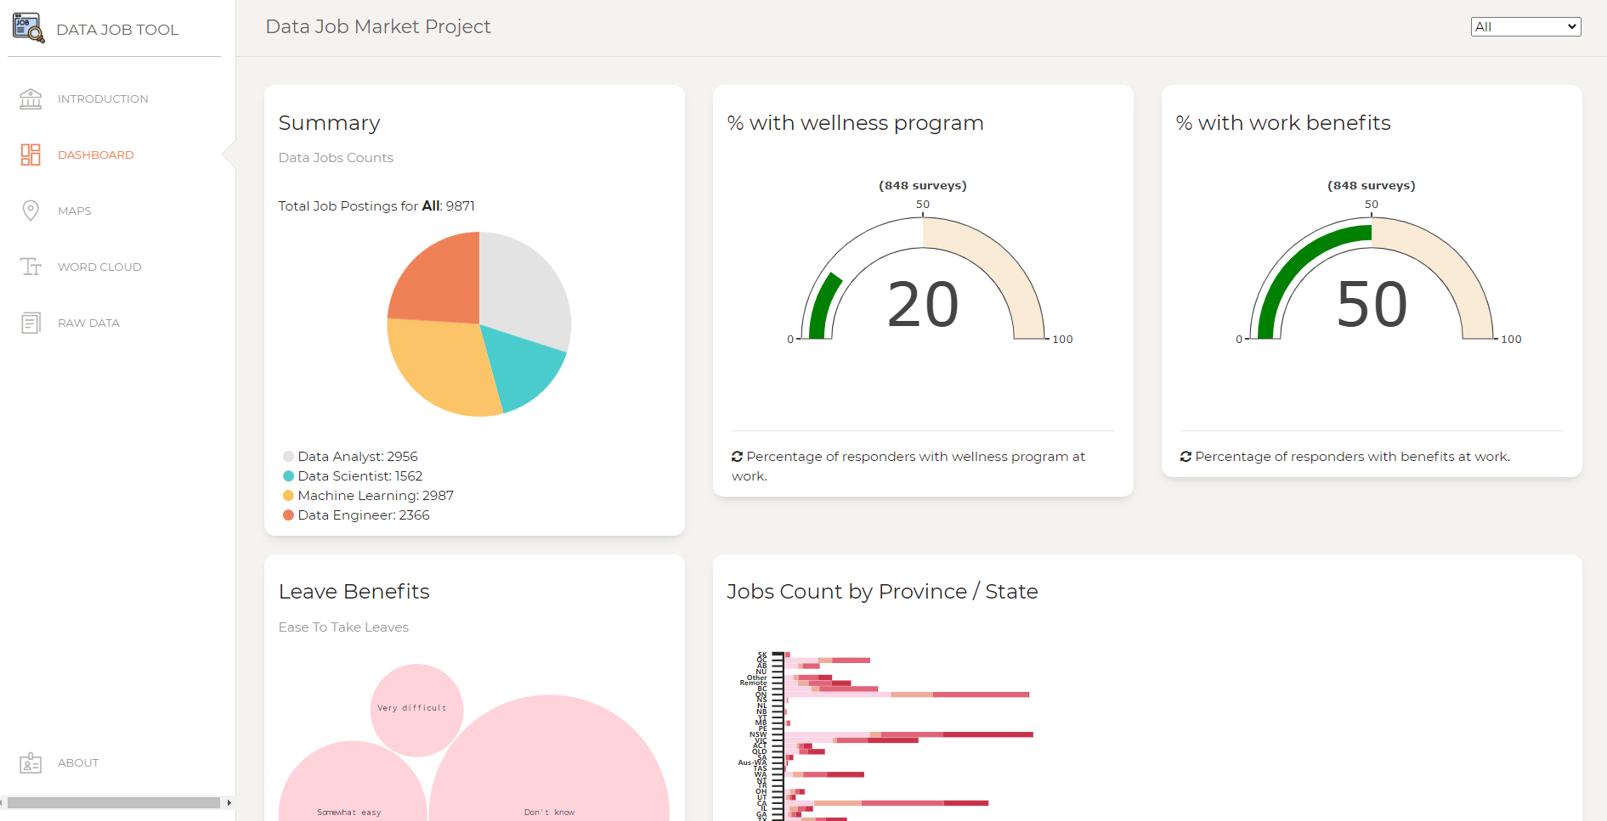
Screenshot of the dashboard

Slide 14





Apps Structure
Flask
SQL Alchemy
Used to render html and API routes
Query data from database and present them as APIs
Html & Heroku
Java Script
Used Bootstrap template for the dashboard
Reference all JS files and necessary dependencies
Heroku to host our dashboard
JS libraries used to create charts:
Plotly
D3
Leaflet
WordCloud (not covered in class)
Notes:
<a href='https://www.freepik.com/photos/technology'>Technology photo created by kjpargeter - www.freepik.com</a>

Slide 15
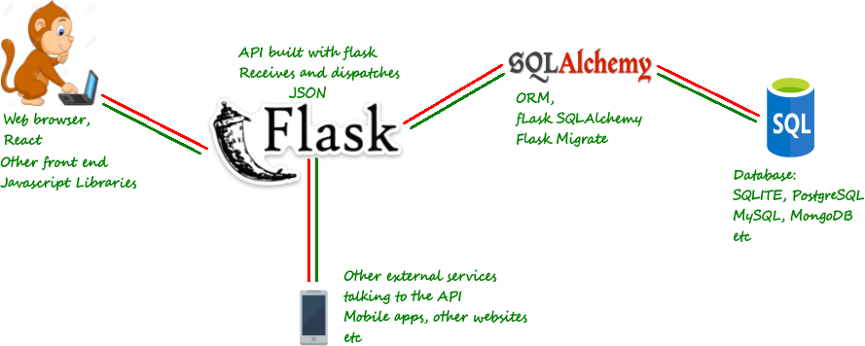
Dashboard Design
Flask by example 5 (How to build a simple REST API) (danidee10.github.io)

Slide 16
Results
4
Notes:
Kelvin

Slide 17
Place your screenshot here
App
Launching
Data Job Dashboard (datajobapp.herokuapp.com)

Slide 18
Summary of Insights
5
Answers to our questions.
Notes:
Navy

Slide 19

9,871
254
1,115
Total Job Postings
Remote Jobs
Cities
Notes:
As Kelvin had shown in the app, at the current state, user can toggle the drop down menu and see a comprehensive visualization dashboard for a particular country or all 4 countries in total
For example, if we left the selection to “All”, then some of the results can be observed as shown in this slide.

Slide 20
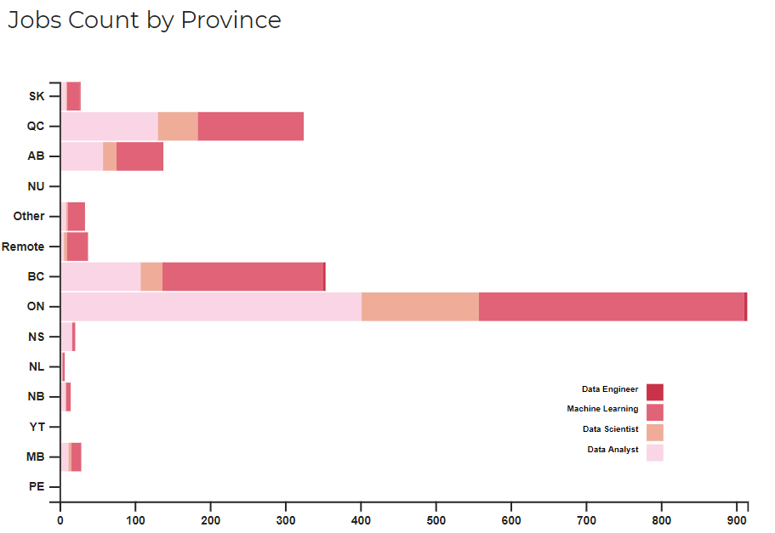
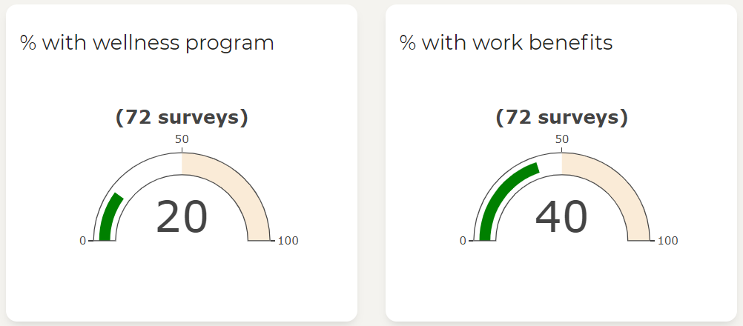
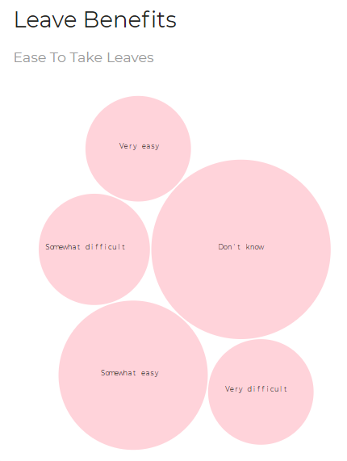
Summary
CA focused results
Many data jobs are in ON, followed by BC, some Remote Jobs
In ON: majority of jobs are in and surrounding Toronto
Data Analyst >> Data Engineer >> Data Scientist >> Machine Learning
In BC: majority of jobs are in Vancouver
Data Engineer >> Data Analyst >> Data Scientist >> Machine Learning
Most survey responders reported either “Don’t know” or “Somewhat easy” to take leaves
20% have wellness program at work
40% have work benefits
Notes:
This slide summarizes some results observed from the dashboard focusing on Canada
As we saw earlier, pla pla pla (read the slide) → this statistics provide users an insight of the demand of different data roles. So depending on their expertise, he or she can make adata-driven decision to either move to ON or BC as an example in this case.
The dashboard also gives you an insight of how easy it is to take leaves or if if there are work benefits included in the particular country
Similarly, a user can explore the job market demand for other 3 countries, in case he/she would like to work abroad

Slide 21
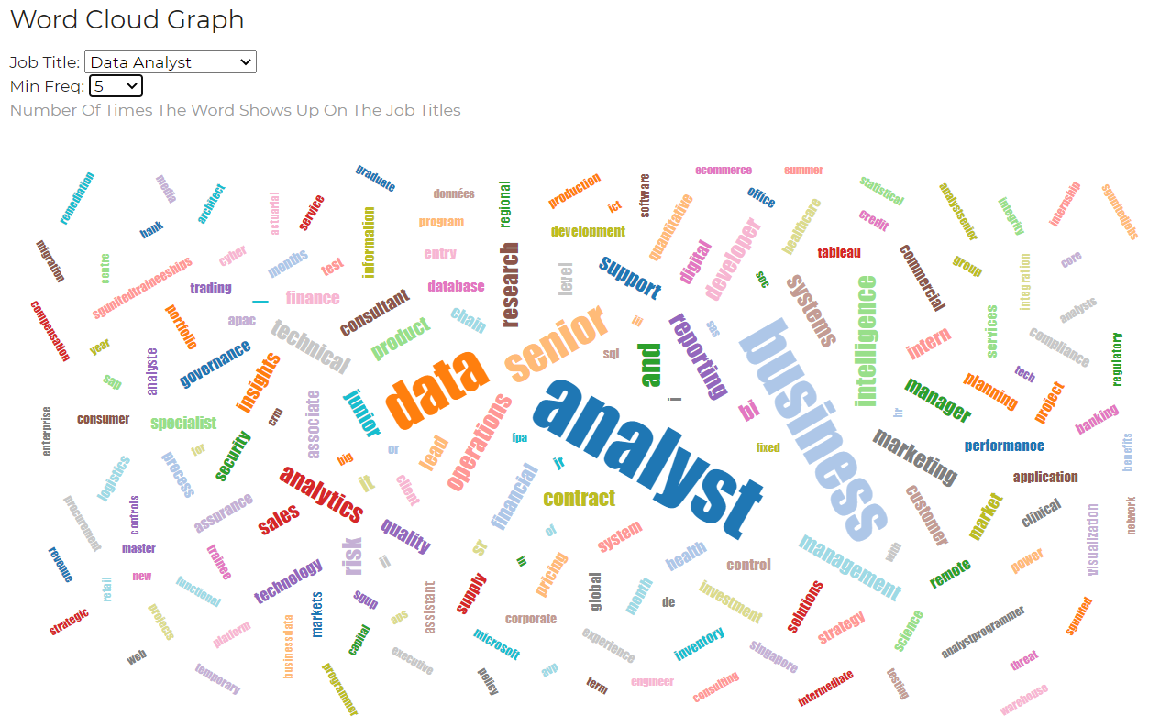
Notes:
Another useful information a user can get from this dashboard is to find the key words that are widely used in the industry or in job postings
The user can change the frequency to example 5, meaning the key word appears at least 5 times in all the Data Analyst job postings
As you can see, the bigger the word the more likely the user can find a relevant job if he/she uses it in job searches

Slide 22
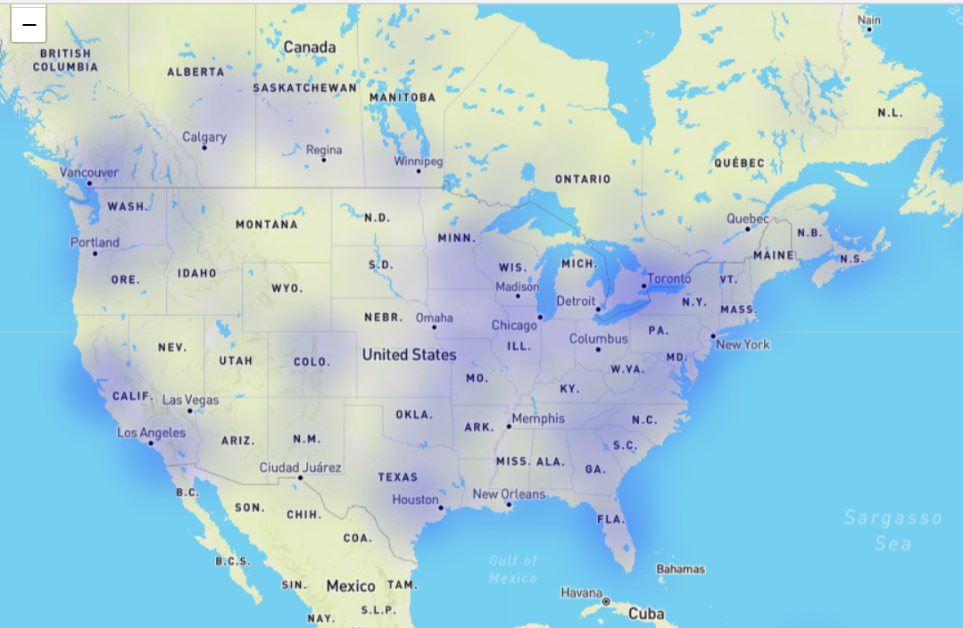
Notes:
The heatmap provides a holistic view of the job postings, so the user can see which provinces have more postings than another
This will gain help user to make information decision on where they want to move to for more job opportunities

Slide 23
Repositories
1. ETL:
Source code : angmay/DataJobMarket (github.com)
This notebook will perform following tasks:
Web Scrape data from Indeed
Perform data transformation
Load data onto either PostgreSQL or ElephantSQL
2. Dashboard Creation:
Source code: Navyhoang/Project2-DataJobs-App (github.com)
This will perform the following tasks:
Query new data from databases above
Deploy the app with new data accordingly

Slide 24
Future Work
6
Notes:
Su

Slide 25
Future Work
Tablet and Mobile App
Deploy the app for different screen sizes
More user interactions
Add more features to improve users experience
Add more drilldown options (city, job titles, salary ranges, etc.)
Improve accuracy w/ more data
Expand database to include job postings and surveys from more countries, and other valuable information such as salaries
Real-time Update
Update dashboard with latest job postings
Trend Predictions
Predict data job demand using Linear Regression
Job Classification
Classify job postings based on key words using natural language processing

Slide 26
THANKS!
Any questions?

Slide 27
References
[1] | Newsroom, "Data Analyst, the most in-demand job of the coming years," 2018 February 21. [Online]. Available: https://www.morningfuture.com/en/article/2018/02/21/data-analyst-data-scientist-big-data-work/235/.
[2] | Purdue University Global, "Rise of the Data Analyst—What’s Behind the Boom?," 16 September 2019. [Online]. Available: https://www.purdueglobal.edu/blog/information-technology/rise-of-data-analyst/.
[3] | edureka, "10 Reasons Why Big Data Analytics is the Best Career Move," 23 July 2020. [Online]. Available: https://www.edureka.co/blog/10-reasons-why-big-data-analytics-is-the-best-career-move.
[4] | SAS, "ETL What it is and why it matters," [Online]. Available: https://www.sas.com/en_ca/insights/data-management/what-is-etl.html.
[5] | Open Sourcing Mental Illness, LTD, "Mental Health in Tech Survey," 2014. [Online]. Available: https://www.kaggle.com/osmi/mental-health-in-tech-survey. [Accessed 15 December 2020].
[6] | M. O'Neill, "World University Rankings," 2019. [Online]. Available: https://www.kaggle.com/mylesoneill/world-university-rankings. [Accessed 15 December 2020].
[7] | Indeed Singapore, "Indeed Singapore," [Online]. Available: https://sg.indeed.com/. [Accessed 15 December 2020].
[8] | Indeed Canada, "Indeed Canada," [Online]. Available: https://ca.indeed.com/. [Accessed 15 December 2020].
[9] | Indeed Australia, "Indeed Australia," [Online]. Available: https://au.indeed.com/. [Accessed 15 December 2020].
[10] | Indeed US, "Indeed US," [Online]. Available: https://www.indeed.com/. [Accessed 15 December 2020].

